Slide 1

React js
Group 12

Slide 2

Group Members
GAM/IT/2022/F/0102-A.D.Shaminda Gunasekara
GAM/IT/2022/F/0117-Dinusha Wanninayaka
GAM/IT/2022/F/0012-J.Sudharshini
GAM/IT/2022/F/0056-K.G.D.Prabodhani
GAM/IT/2022/F/0027-L.A.T.Kalsara

Slide 3
CONTENTS
Introduction of React js
01
02
02
How to install React js
03
Errors and fixing methods
04
Our creation
05
Point of view

Slide 4

Original author(s)
Developer(s)
Initial release
Jordan Walke
Meta and community
May29,2013
Written in
Web development
Type
JavaScript
Front End
JavaScript library

Slide 5


How to install React.js
Install Node.js: Download and install Node.js from nodejs.org. This includes npm (Node Package Manager).
Create a New React App:
Navigate to the Project Folder:
Start the Development Server:

Slide 6


Slide 7
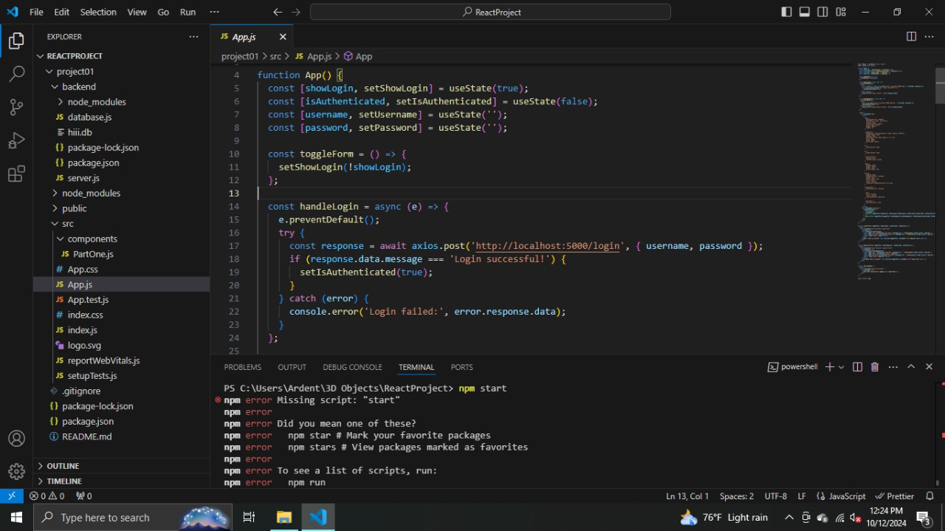

ERRORS
How to fix it
1. Clear npm cache

Slide 8


2. Delete node_modules and package-lock.json
3. File Missing Files (Package.json)
4.Check Node and npm Installation
5.Kills node prossess

Slide 9
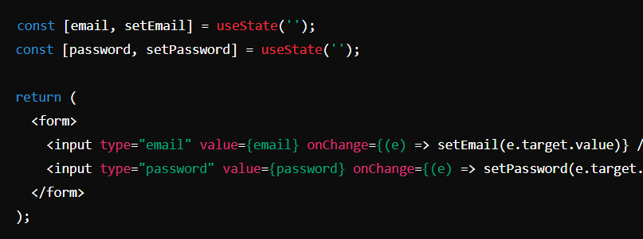
ERRORS
Controlled vs. Uncontrolled Components
Error: Not using controlled components.
Fix: Manage input state with useState and onChange handlers.

Slide 10
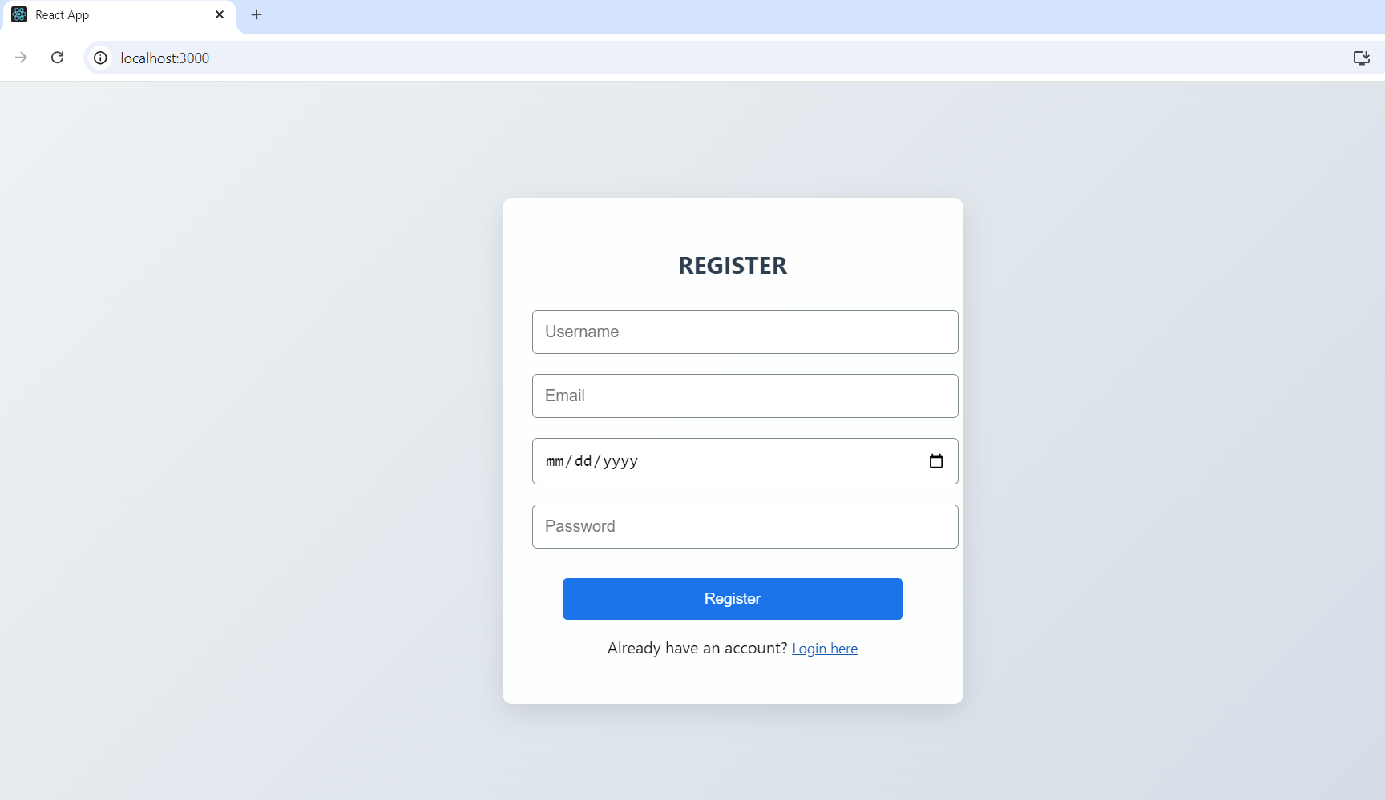
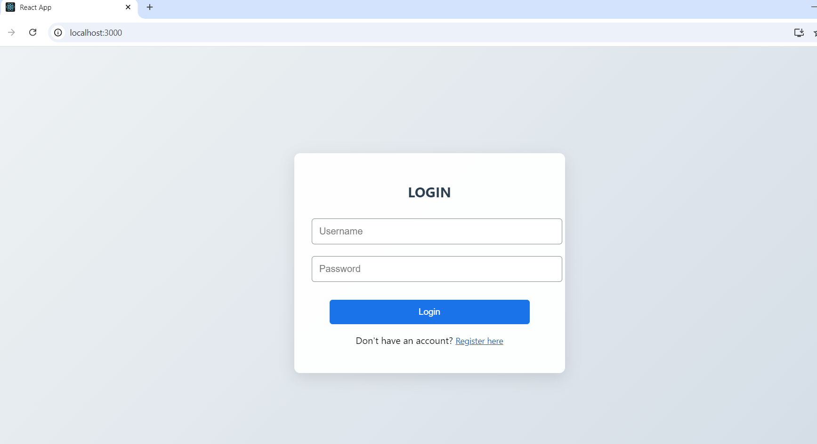
Our Creation

Slide 11
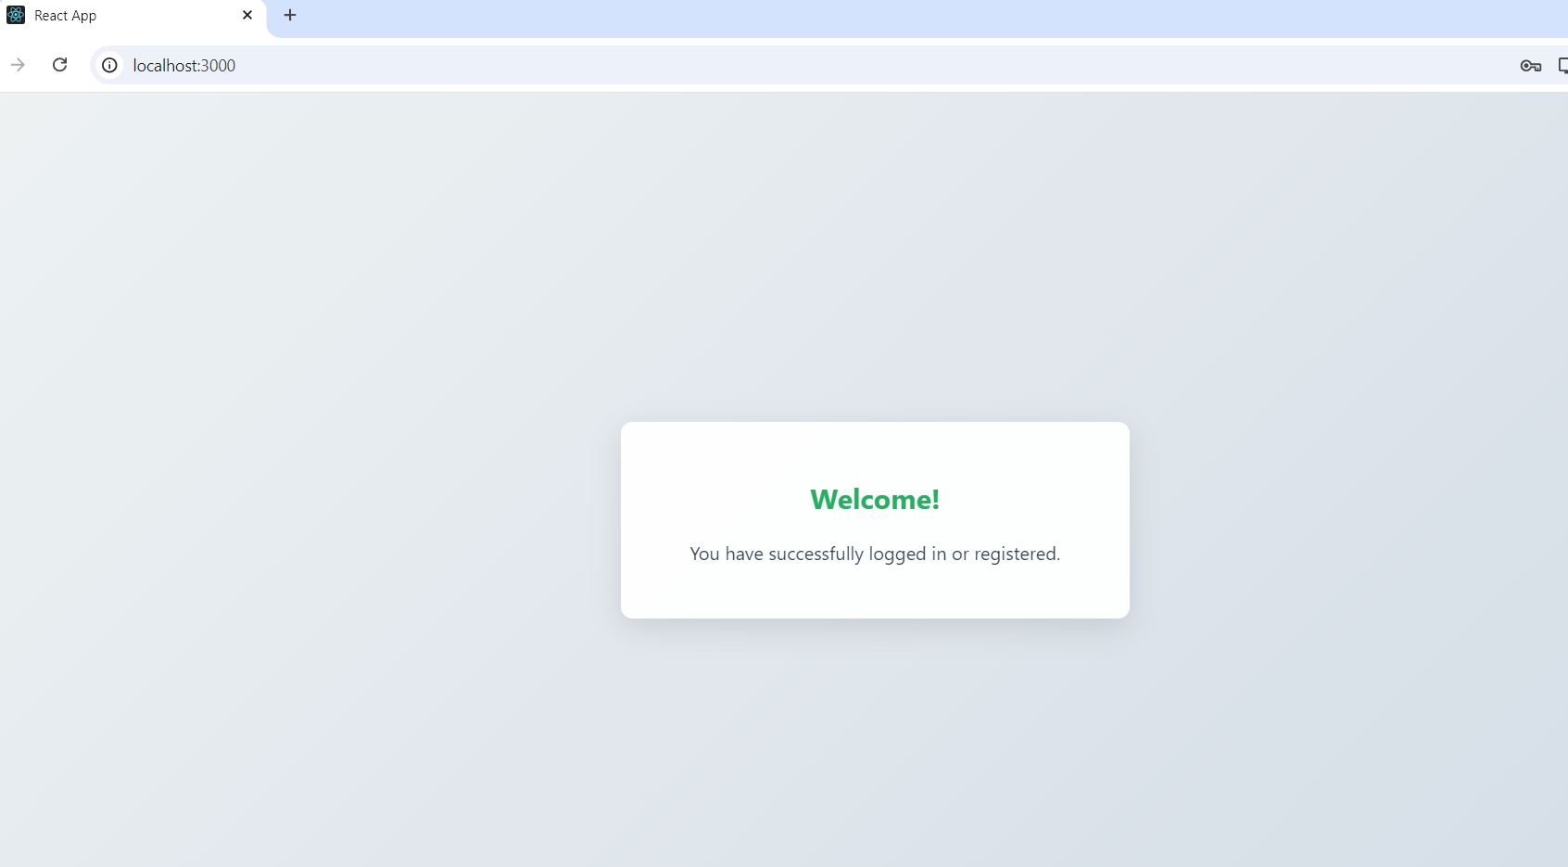
Success To Login

Slide 12
Point of view
Using React.js offers several advantages for building web applications
Component-Based Architecture
Virtual DOM
Declarative Syntax
Cross-Platform Development
Community Support
Overall, React.js is a powerful choice for building dynamic, high-performance web applications.

Slide 13
THANKS!
DO YOU HAVE ANY QUESTIONS……?

